Slide 1
Spring Form Contollers

Slide 2
SimpleFormController
A Form Controller with features for:
Viewing
Validating
Submitting

Slide 3
SimpleFormController
Properties:
formView: the logical name for the page containing the form
successView: the logical name for the page to show after a successful form submission

Slide 4
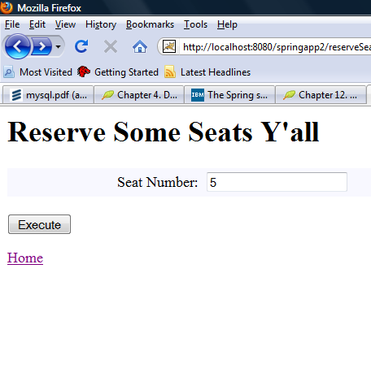
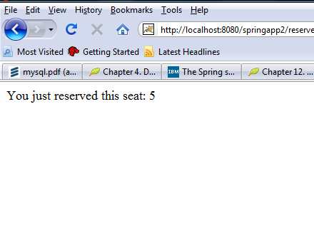
FormView and SuccessView
FormView
SuccessView

Slide 5
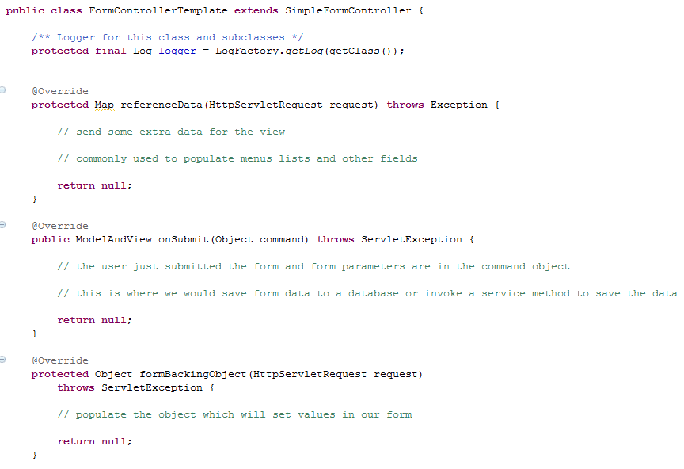
A First Look At SimpleFormController

Slide 6
A Look at Three Methods
These methods will commonly be implemented for basic FormController developent:
formBackingObject()
referenceData()
onSubmit()

Slide 7
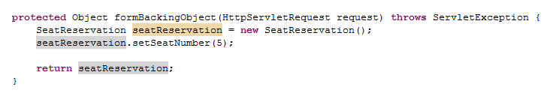
formBackingObject()
Populate an object which you can reference on a jsp!

Slide 8
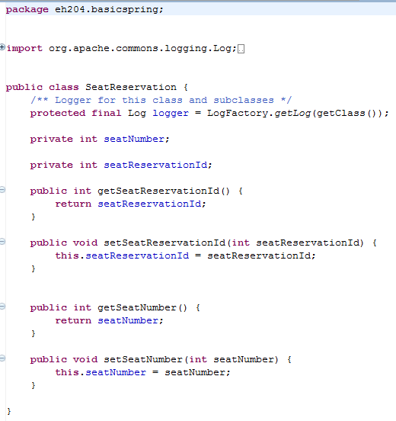
The Command Object: SeatReservation.java

Slide 9
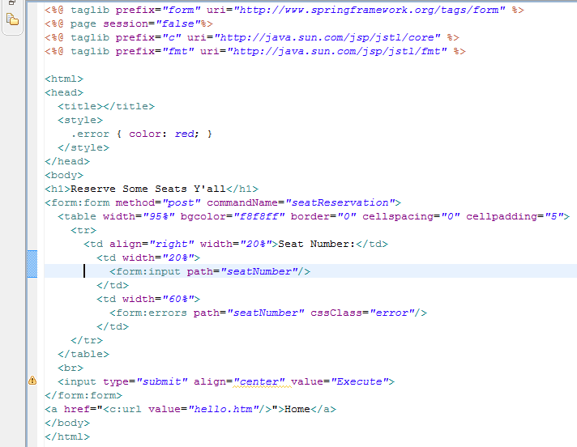
The JSP
Spring form tag library
Reference to the form backing object

Slide 10
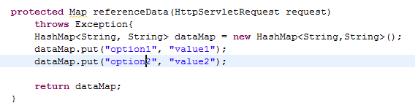
referenceData()
Add some extra data that might be used in a form.

Slide 11
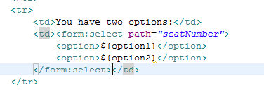
The Reference Data in the JSP

Slide 12
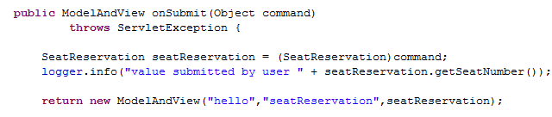
onSubmit()
Process the data submitted by the user

Slide 13
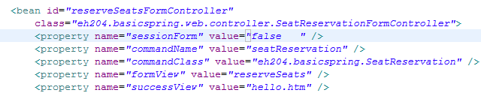
Controller Configuration
sessionForm determines whether the container uses the same instance of the command object or not. A setting to false forces the instantiation of a new instance per request

Slide 14
ControllerConfiguration
commandName is the name of the command object parameter used in the FormController

Slide 15
ControllerConfiguration
commandClass is the complete class name for the command object

Slide 16
Controller Configuration
formView is the logical name for the form view
successView is the logical name for the view to show after a successful submission

Slide 17
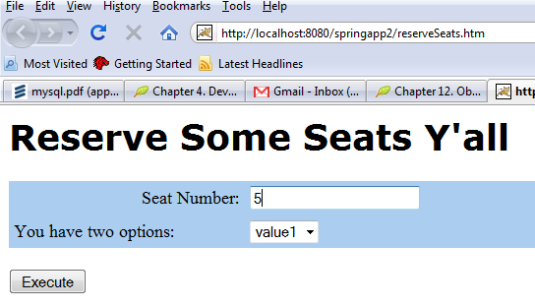
protected Object formBackingObject(HttpServletRequest request)
throws ServletException {
SeatReservation seatReservation = new SeatReservation();
seatReservation.setSeatNumber(5);
return seatReservation;
}
5
Populates the commandObject

Slide 18
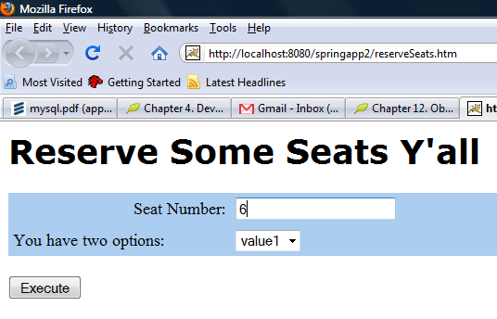
User submits the form
6
Populates the commandObject
public ModelAndView onSubmit(Object Command){
SeatReservation seatReservation = (SeatReservation)command;
logger.info("value submitted by user " +
seatReservation.getSeatNumber());
}

Slide 19
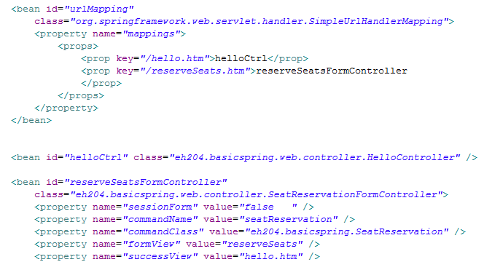
Quick URLMapping Review

Slide 20
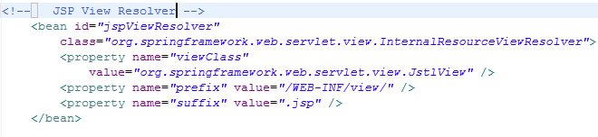
Quick View Resolver Review
prefix
suffix
If the logical view name is : reservationForm
ViewResolver translates it to:
/WEB-INF/view/reservationForm.jsp
prefix
suffix

Slide 21
